Slide 1
Functions & loops in r
EFGH Data Core
In-person orientation, Nairobi
Olivia Schultes
Aug 19, 2025

Slide 2
Why?
Purpose: perform the same data manipulation iteratively
Advantages
Efficiency (fewer lines of code)
Reduces likelihood of copying mistakes
Easier to update
Applications
Calculating a new variable
Performing the same analysis across a set of predictor variables
Producing figures by different subsets of data
And so much more…

Slide 3

For-loops

Slide 4
structure
for (value in sequence) {
statement
}
2 inputs: value and sequence
Sequence is vector of terms you’d like the operation to be applied to
Value is a stand-in for each value in the sequence
Statement describes the data manipulation applied to each value in sequence

Slide 5
basics
for (x in 1:10) {
print(x)
}
> [1] 1
> [1] 2
> [1] 3
> [1] 4
> [1] 5
…
vec <- NULL
seq <- 1:10
for (i in seq) {
vec[i] <- i
}
print(vec)
> [1] 1 2 3 4 5 6 7 8 9 10
Notes:
In the first example, we’re asking the for loop to consecutively print the numbers 1 through 10. In the second example, we’re creating a new object vec, where we assign a value to different indices of vec, and then printing that object outside the for loop.

Slide 6
basics
for (x in 1:10) {
print(x)
}
> [1] 1
> [1] 2
> [1] 3
> [1] 4
> [1] 5
…
vec <- NULL
seq <- 1:10
for (i in seq) {
vec[i] <- i
}
print(vec)
> [1] 1 2 3 4 5 6 7 8 9 10
Can use different letters for value

Slide 7
basics
for (x in 1:10) {
print(x)
}
> [1] 1
> [1] 2
> [1] 3
> [1] 4
> [1] 5
…
vec <- NULL
seq <- 1:10
for (i in seq) {
vec[i] <- i
}
print(vec)
> [1] 1 2 3 4 5 6 7 8 9 10
Can specify sequence outside of or within for loop

Slide 8
basics
for (x in 1:10) {
print(x)
}
> [1] 1
> [1] 2
> [1] 3
> [1] 4
> [1] 5
…
vec <- NULL
seq <- 1:10
for (i in seq) {
vec[i] <- i
}
print(vec)
> [1] 1 2 3 4 5 6 7 8 9 10
New object containing values from sequence: vec
No new object created!
Notes:
1st example is classically used when introducing for loops
However, this is not very helpful; usually, we are trying to create something new with for loops, and here we don’t have a new object we can use
Let’s look at the 2nd example instead
First we specify an empty object vec
Then in the statement, we assign the current value of I to each ith index of vec
So the first time we run through the loop, the first index of vec is assigned a value of 1, the second time the second index is assigned to 2, etc.
At the end we have changed the value of vec and now have an object in our global environment that we can work with (do things like print)

Slide 9
basics
for (x in 1:10) {
print(x)
}
> [1] 1
> [1] 2
> [1] 3
> [1] 4
> [1] 5
…
vec <- NULL
seq <- 1:10
for (i in seq) {
vec[i] <- i
}
print(vec)
> [1] 1 2 3 4 5 6 7 8 9 10
Notes:
1st example is classically used when introducing for loops
However, this is not very helpful; usually, we are trying to create something new with for loops, and here we don’t have a new object we can use
Let’s look at the 2nd example instead
First we specify an empty object vec
Then in the statement, we assign the current value of i to each ith index of vec
So the first time we run through the loop, the first index of vec is assigned a value of 1, the second time the second index is assigned to 2, etc.
At the end we have changed the value of vec and now have an object in our global environment that we can work with (do things like print)

Slide 10
global vs local environments
What happens if we don’t create vec before the for loop?
We can’t assign values to an index of an object that doesn’t exist
Returns an error
# vec <- NULL
seq <- 1:10
for (i in seq) {
vec[i] <- i
}
Error: object ‘vec’ not found

Slide 11
global vs local environments
seq <- 1:10
for (i in seq) {
vec <- vec
vec[i] <- i
}
Error: object ‘vec’ not found
seq <- 1:10
for (i in seq) {
vec <- 0
vec[i] <- i
}
print(vec)
> [1] 0 NA NA NA NA NA NA NA NA 10
vec still never created
vec created within the function
Each time the function loops around a new index is added, but the value of the first index is returned to 0
Only the value assigned to the last index (10) is retained

Slide 12
global vs local environments
vec <- NULL
seq <- 1:10
for (i in seq) {
vec[i] <- i
}
print(vec)
> [1] 1 2 3 4 5 6 7 8 9 10
seq <- 1:10
for (i in seq) {
vec <- 0
vec[i] <- i
}
print(vec)
> [1] 0 NA NA NA NA NA NA NA NA 10
Created in the global environment
Created in the local environment
Notes:
Within the for loop, a local environment is created
Objects created within that environment will be created each time the loop is run
Often, it is a better option to create an empty object (vector/data frame/list) in the global environment and simply manipulate or modify it within the for loop

Slide 13
Example 1: reading in files
rds_list <- list.files(path = , pattern = "*.Rds", full.names = TRUE)
name_list <- sub("./", "", rds_list)
name_list <- sub(".Rds", "", name_list)
for (i in 1:length(rds_list)) {
assign(name_list[i], readRDS(rds_list[i]))
}

Slide 14
Example 1: reading in files
setwd("./../../../Data/Key data")
rds_list <- list.files(path = , pattern = "*.Rds", full.names = TRUE)
name_list <- sub("./", "", rds_list)
name_list <- sub(".Rds", "", name_list)
for (i in 1:length(rds_list)) {
assign(name_list[i], readRDS(rds_list[i]))
}
Key functions:
list.files – create character vector with files in a certain folder
assign – assign a value to a name in an environment

Slide 15
Example 1: reading in files
setwd("./../../../Data/Key data")
rds_list <- list.files(path = , pattern = "*.Rds", full.names = TRUE)
name_list <- sub("./", "", rds_list)
name_list <- sub(".Rds", "", name_list)
for (i in 1:length(rds_list)) {
assign(name_list[i], readRDS(rds_list[i]))
}
head(rds_list)
> [1] "./cause_of_death.Rds" "./costing_enrollment.Rds" "./costing_followup.Rds"
head(name_list)
> [1] "cause_of_death" "costing_enrollment" "costing_followup"
Notes:
we have 2 vectors of the same length with the names of file pathways and desired object names in the same order

Slide 16
Example 1: reading in files
setwd("./../../../Data/Key data")
rds_list <- list.files(path = , pattern = "*.Rds", full.names = TRUE)
name_list <- sub("./", "", rds_list)
name_list <- sub(".Rds", "", name_list)
for (i in 1:length(rds_list)) {
assign(name_list[i], readRDS(rds_list[i]))
}
Were the new objects created in the global environment or the local environment?

Slide 17

Functions

Slide 18
structure
function_name <- function(argument1, …) {
function
}
There are 2 major components of functions
Arguments or inputs
The function itself, which is a set of statements that perform a specific task
Functions can have 0, 1, or many arguments
We create a function using the function() argument and assign it the name function_name
This function is then stored in the global environment

Slide 19
function with no arguments
func_noarg <- function() {
print(“Hello world”)
}
func_noarg()
> “Hello world”

Slide 20
function with 1 argument
func_onearg <- function(x) {
print(paste0(“Hello ”, x))
}
func_onearg(“Olivia”)
> “Hello Olivia”

Slide 21
function with many arguments
func_manyarg <- function(x, y) {
x^2 + y
}
func_manyarg(x=3, y=4)
> [1] 13

Slide 22
function with many arguments
func_manyarg <- function(x, y) {
x^2 + y
}
func_manyarg(x=3, y=4)
> [1] 13
func_manyarg(3, 4)
> [1] 13
Notes:
note we get the same result even if we don’t specify the name of each argument (x and y) because R remembers the order of arguments

Slide 23
function with many arguments
func_manyarg <- function(x, y) {
x^2 + y
}
func_manyarg(x=3, y=4)
> [1] 13
func_manyarg(3, 4)
> [1] 13
func_manyarg(4, 3)
> [1] 19
func_manyarg(y=4, x=3)
> [1] 13
Notes:
but the arguments must follow the order specified in the original function. See how when we flip the order of the arguments without specifying, the first argument is still treated as x. We can flip the order, but in this case we have to specify each argument

Slide 24
function with default arguments
func_defaultarg <- function(x = 3, y = 4) {
x^2 + y
}
func_defaultarg()
> [1] 13
Notes:
We can also specify default arguments. If the function is called without arguments, the default values will be used

Slide 25
function with default arguments
func_manyarg <- function(x = 3, y = 4) {
x^2 + y
}
func_manyarg()
> [1] 13
func_manyarg(2)
> [1] 8
func_manyarg(y=5)
> [1] 14
func_manyarg(2, 5)
> [1] 9
Notes:
We can still specify all arguments when we call the function, or specify some of the arguments in the function and leave other values as the default. Note that if we want to leave the default value for the first argument but not subsequent arguments, we will have to name the arguments in our function because of how R understands argument order

Slide 26
Example 1: producing plots iteratively
scrambled_data
site enr_age_months episode_duration_length
> [1] Bangladesh 12 5
> [2] Bangladesh 30 3
> [3] Bangladesh 23 7
> [4] Bangladesh 9 6
> [5] Bangladesh 16 8
> [6] Kenya 33 9
> [7] Kenya 21 4
> [8] Kenya 7 12
> [9] Kenya 15 4
> [10] Kenya 20 5
Notes:
Data structure

Slide 27
Example 1: producing plots iteratively
produce_figure = function(site="all") {
if(site==“all") {
df = scrambled_data
} else {
df = scrambled_data %>% filter(enroll_site=={{site}})
}
ggplot(data = df,
aes(x=enr_age_months, y=episode_duration_length)) +
geom_point(alpha = 0.2, shape = 19)
}
scrambled_data
site enr_age_months episode_duration_length
> [1] Bangladesh 12 5
> [2] Bangladesh 30 3
> [3] Bangladesh 23 7
> [4] Bangladesh 9 6
> [5] Bangladesh 16 8
> [6] Kenya 33 9
> [7] Kenya 21 4
> [8] Kenya 7 12
> [9] Kenya 15 4
> [10] Kenya 20 5

Slide 28
Example 1: producing plots iteratively
produce_figure = function(site="all") {
if(site==“all") {
df = scrambled_data
} else {
df = scrambled_data %>% filter(enroll_site=={{site}})
}
ggplot(data = df,
aes(x=enr_age_months, y=episode_duration_length)) +
geom_point(alpha = 0.2, shape = 19)
}
scrambled_data
site enr_age_months episode_duration_length
> [1] Bangladesh 12 5
> [2] Bangladesh 30 3
> [3] Bangladesh 23 7
> [4] Bangladesh 9 6
> [5] Bangladesh 16 8
> [6] Kenya 33 9
> [7] Kenya 21 4
> [8] Kenya 7 12
> [9] Kenya 15 4
> [10] Kenya 20 5
Conditional statements

Slide 29
Example 1: producing plots iteratively
produce_figure = function(site="all") {
if(site==“all") {
df = scrambled_data
} else {
df = scrambled_data %>% filter(enroll_site=={{site}})
}
ggplot(data = df,
aes(x=enr_age_months, y=episode_duration_length)) +
geom_point(alpha = 0.2, shape = 19)
}
scrambled_data
site enr_age_months episode_duration_length
> [1] Bangladesh 12 5
> [2] Bangladesh 30 3
> [3] Bangladesh 23 7
> [4] Bangladesh 9 6
> [5] Bangladesh 16 8
> [6] Kenya 33 9
> [7] Kenya 21 4
> [8] Kenya 7 12
> [9] Kenya 15 4
> [10] Kenya 20 5
Input data frame

Slide 30
Example 1: producing plots iteratively
produce_figure = function(site="all") {
if(site==“all") {
df = scrambled_data
} else {
df = scrambled_data %>% filter(enroll_site=={{site}})
}
ggplot(data = df,
aes(x=enr_age_months, y=episode_duration_length)) +
geom_point(alpha = 0.2, shape = 19)
}
scrambled_data
site enr_age_months episode_duration_length
> [1] Bangladesh 12 5
> [2] Bangladesh 30 3
> [3] Bangladesh 23 7
> [4] Bangladesh 9 6
> [5] Bangladesh 16 8
> [6] Kenya 33 9
> [7] Kenya 21 4
> [8] Kenya 7 12
> [9] Kenya 15 4
> [10] Kenya 20 5
Object created inside function

Slide 31
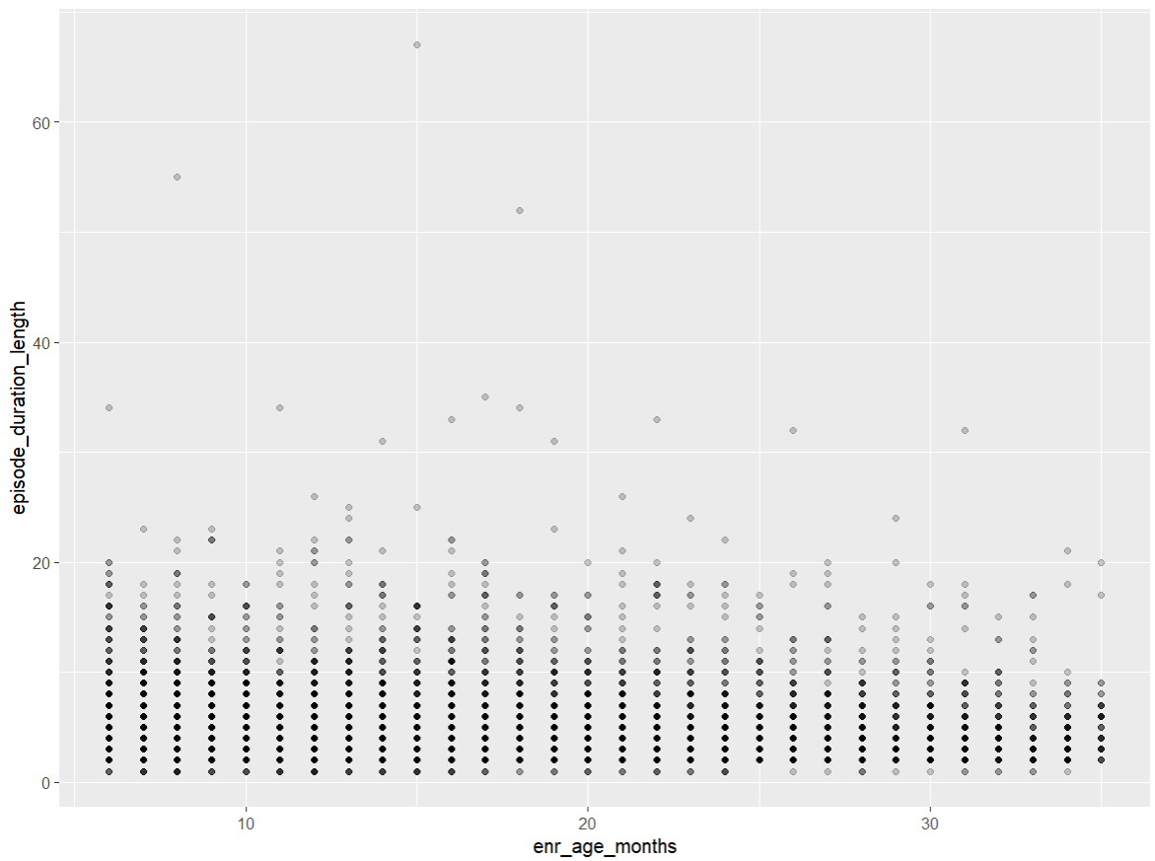
Example 1: producing plots iteratively
produce_figure = function(site="all") {
if(site==“all") {
df = scrambled_data
} else {
df = scrambled_data %>% filter(enroll_site=={{site}})
}
ggplot(data = df,
aes(x=enr_age_months, y=episode_duration_length)) +
geom_point(alpha = 0.2, shape = 19)
}
produce_figure()

Slide 32
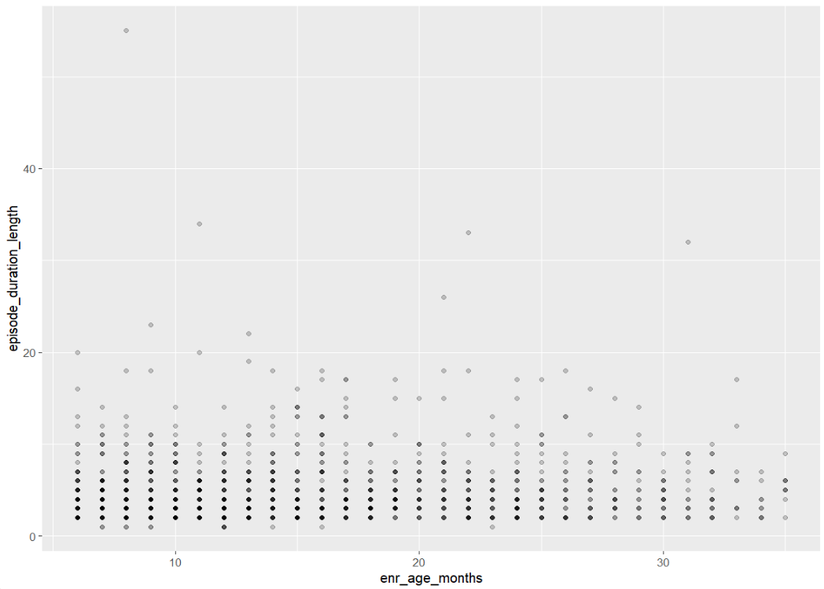
Example 1: producing plots iteratively
produce_figure = function(site="all") {
if(site==“all") {
df = scrambled_data
} else {
df = scrambled_data %>% filter(enroll_site=={{site}})
}
ggplot(data = df,
aes(x=enr_age_months, y=episode_duration_length)) +
geom_point(alpha = 0.2, shape = 19)
}
produce_figure(site=“Bangladesh”)

Slide 33
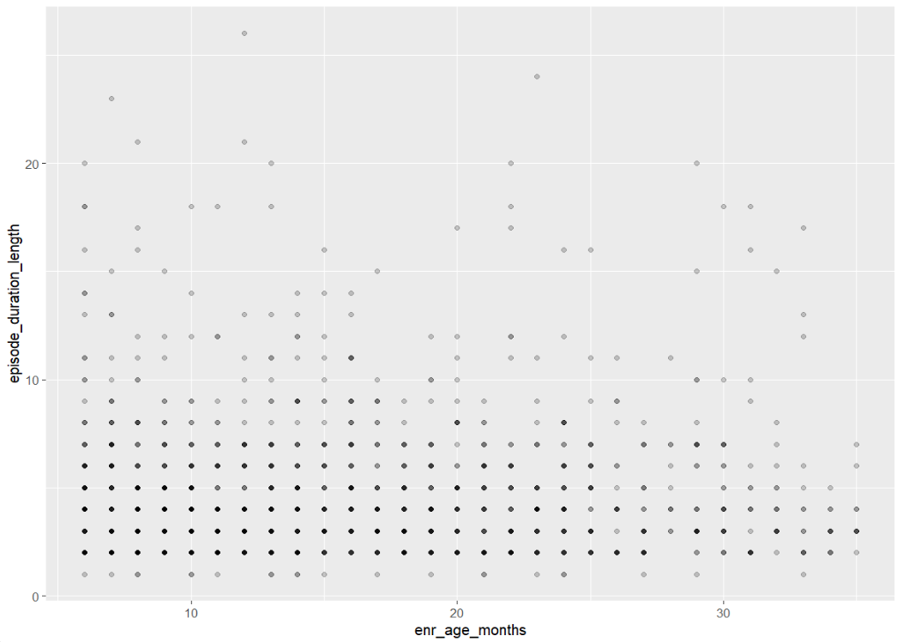
Example 1: producing plots iteratively
produce_figure = function(site="all") {
if(site==“all") {
df = scrambled_data
} else {
df = scrambled_data %>% filter(enroll_site=={{site}})
}
ggplot(data = df,
aes(x=enr_age_months, y=episode_duration_length)) +
geom_point(alpha = 0.2, shape = 19)
}
produce_figure(“Mali”)

Slide 34
Example 2: running a function through nested for-loops
Purpose
Assess how well four different measures of diarrhea severity predict hospitalization after the diarrhea episode
Details
Calculate five measures of diagnostic accuracy (sensitivity, specificity, diagnostic accuracy, positive predictive value, negative predictive value)
Among combinations of 2 sub-groups
Pathogen (all diarrhea vs. Shigella)
Treatment (overall, any antibiotics, and none)

Slide 35
Example 2: running a function through nested for-loops
calculate_diagnostic_accuracy = function(d, severity_definition, denominator, antibiotics) {
two_by_two = d %>%
group_by(!!!syms(severity_definition), hosp_factor) %>%
summarise(n = n(), .groups = "keep")
test = epi.tests(two_by_two, method = "exact", digits = 2, conf.level = 0.95)
result = test$detail |>
filter(statistic=="se" | statistic=="sp" | statistic=="pv.pos" | statistic=="pv.neg" | statistic=="diag.ac") |>
select(statistic, est) |>
rename(value = est, measure = statistic) |>
mutate(value = value*100) |>
mutate(severity_definition = {{severity_definition}},
denom = {{denominator}},
antibiotics = {{antibiotics}})
return(result)
}
Notes:
the function

Slide 36
Example 2: running a function through nested for-loops
calculate_diagnostic_accuracy = function(d, severity_definition, denominator, antibiotics) {
two_by_two = d %>%
group_by(!!!syms(severity_definition), hosp_factor) %>%
summarise(n = n(), .groups = "keep")
test = epi.tests(two_by_two, method = "exact", digits = 2, conf.level = 0.95)
result = test$detail |>
filter(statistic=="se" | statistic=="sp" | statistic=="pv.pos" | statistic=="pv.neg" | statistic=="diag.ac") |>
select(statistic, est) |>
rename(value = est, measure = statistic) |>
mutate(value = value*100) |>
mutate(severity_definition = {{severity_definition}},
denom = {{denominator}},
antibiotics = {{antibiotics}})
return(result)
}
Input data
Notes:
We specify the input data as “d”

Slide 37
Example 2: running a function through nested for-loops
calculate_diagnostic_accuracy = function(d, severity_definition, denominator, antibiotics) {
two_by_two = d %>%
group_by(!!!syms(severity_definition), hosp_factor) %>%
summarise(n = n(), .groups = "keep")
test = epi.tests(two_by_two, method = "exact", digits = 2, conf.level = 0.95)
result = test$detail |>
filter(statistic=="se" | statistic=="sp" | statistic=="pv.pos" | statistic=="pv.neg" | statistic=="diag.ac") |>
select(statistic, est) |>
rename(value = est, measure = statistic) |>
mutate(value = value*100) |>
mutate(severity_definition = {{severity_definition}},
denom = {{denominator}},
antibiotics = {{antibiotics}})
return(result)
}
Calculates measures of interest
Notes:
The first part of the function calculates the measures of interest
So in this case, we create a two by two table and then use the R function epi.tests to calculate sensitivity, specificity, diagnostic accuracy, positive predictive value, and negative predictive value

Slide 38
Example 2: running a function through nested for-loops
calculate_diagnostic_accuracy = function(d, severity_definition, denominator, antibiotics) {
two_by_two = d %>%
group_by(!!!syms(severity_definition), hosp_factor) %>%
summarise(n = n(), .groups = "keep")
test = epi.tests(two_by_two, method = "exact", digits = 2, conf.level = 0.95)
result = test$detail |>
filter(statistic=="se" | statistic=="sp" | statistic=="pv.pos" | statistic=="pv.neg" | statistic=="diag.ac") |>
select(statistic, est) |>
rename(value = est, measure = statistic) |>
mutate(value = value*100) |>
mutate(severity_definition = {{severity_definition}},
denom = {{denominator}},
antibiotics = {{antibiotics}})
return(result)
}
Formatting results
Notes:
In the second part of the function, we format the results to just pull out those five measures and put them in one column.

Slide 39
Example 2: running a function through nested for-loops
calculate_diagnostic_accuracy = function(d, severity_definition, denominator, antibiotics) {
two_by_two = d %>%
group_by(!!!syms(severity_definition), hosp_factor) %>%
summarise(n = n(), .groups = "keep")
test = epi.tests(two_by_two, method = "exact", digits = 2, conf.level = 0.95)
result = test$detail |>
filter(statistic=="se" | statistic=="sp" | statistic=="pv.pos" | statistic=="pv.neg" | statistic=="diag.ac") |>
select(statistic, est) |>
rename(value = est, measure = statistic) |>
mutate(value = value*100) |>
mutate(severity_definition = {{severity_definition}},
denom = {{denominator}},
antibiotics = {{antibiotics}})
return(result)
}
Other arguments for labelling output
Notes:
In the second part of the function we also add three columns that describe the severity definition of interest, the denominator, and the antibiotics grouping. This way, when we generate many results at once, we can keep track of what results belong to which groups.

Slide 40
Example 2: running a function through nested for-loops
calculate_diagnostic_accuracy = function(d, severity_definition, denominator, antibiotics) {
two_by_two = d %>%
group_by(!!!syms(severity_definition), hosp_factor) %>%
summarise(n = n(), .groups = "keep")
test = epi.tests(two_by_two, method = "exact", digits = 2, conf.level = 0.95)
result = test$detail |>
filter(statistic=="se" | statistic=="sp" | statistic=="pv.pos" | statistic=="pv.neg" | statistic=="diag.ac") |>
select(statistic, est) |>
rename(value = est, measure = statistic) |>
mutate(value = value*100) |>
mutate(severity_definition = {{severity_definition}},
denom = {{denominator}},
antibiotics = {{antibiotics}})
return(result)
}
Notes:
Notice that in two places within this function, we are passing along the name of an argument to be manipulated as a variable within the function. In order for R to interpret the argument as something other than an argument within the local environment created within the function, we need to signal that we are “pasting” in the value of the argument

Slide 41
Example 2: running a function through nested for-loops
calculate_diagnostic_accuracy = function(d, severity_definition, denominator, antibiotics) {
two_by_two = d %>%
group_by(!!!syms(severity_definition), hosp_factor) %>%
summarise(n = n(), .groups = "keep")
test = epi.tests(two_by_two, method = "exact", digits = 2, conf.level = 0.95)
result = test$detail |>
filter(statistic=="se" | statistic=="sp" | statistic=="pv.pos" | statistic=="pv.neg" | statistic=="diag.ac") |>
select(statistic, est) |>
rename(value = est, measure = statistic) |>
mutate(value = value*100) |>
mutate(severity_definition = {{severity_definition}},
denom = {{denominator}},
antibiotics = {{antibiotics}})
return(result)
}
Other tricks for calling variables passed along as function arguments:
tidyverse glue syntax (recommended)
{a}
{{a}}
“{a}”
Deprecated but sometimes work
!!sym(a)
UQ(sym(a))
eval(substitute(a))
.data[[a]]
Use the walrus operator (:=) instead of the equals sign (=) within dyplr verbs such as mutate
Notes:
There are many ways to do this. The glue syntax using curly brackets is recommended when using tidyverse piping and verbs, but I’ve found that it doesn’t always work. Here are some alternatives I’ve found to work previously, assuming the passed along variable is called “a”

Slide 42
Example 2: running a function through nested for-loops
calculate_diagnostic_accuracy(d = scrambled_data,
severity_definition = “mvs_factor”,
denominator = “all diarrhea”,
antibiotics = “overall”)
calculate_diagnostic_accuracy = function(d, severity_definition, denominator, antibiotics) {
two_by_two = d %>%
group_by(!!!syms(severity_definition), hosp_factor) %>%
summarise(n = n(), .groups = "keep")
test = epi.tests(two_by_two, method = "exact", digits = 2, conf.level = 0.95)
result = test$detail |>
filter(statistic=="se" | statistic=="sp" | statistic=="pv.pos" | statistic=="pv.neg" | statistic=="diag.ac") |>
select(statistic, est) |>
rename(value = est, measure = statistic) |>
mutate(value = value*100) |>
mutate(severity_definition = {{severity_definition}},
denom = {{denominator}},
antibiotics = {{antibiotics}})
return(result)
}
measure value severity_definition denom antibiotics
se 77.1 mvs_factor all diarrhea overall
sp 3.5 mvs_factor all diarrhea overall
diag.ac 59.2 mvs_factor all diarrhea overall
pv.pos 71.3 mvs_factor all diarrhea overall
pv.neg 4.7 mvs_factor all diarrhea overall
Notes:
testing function to see if it works

Slide 43
Example 2: running a function through nested for-loops
definitions_severity = c(“mvs_factor”, “mvs_or_dysentery_factor”,
“clark_factor”, “gems_msd_factor”)
denom = c(“all diarrhea”, “shigella”)
antibiotics = c(“overall”, “antibiotics”, “no antibiotics”)
diagnostic accuracy = data.frame()
Notes:
now we set up objects to use in the for-loops

Slide 44
Example 2: running a function through nested for-loops
for(i in definitions_severity) {
for(j in denom) {
for(k in antibiotics) {
if (j==“all diarrhea”) { d = scrambled_data
} else if (j==“shigella”) { d = scrambled_data |> filter(positive_tac_or_culture==1)
} else (“Error: incorrect denominator argument)
if (k==“overall”) { d = d
} else if (k==“antibiotics”) { d = d |> filter(any_abx==1)
} else if (k==“no antibiotics”) { d = d |> filter(any_abx==0)
} else (“Error: incorrect antibiotics argument)
diagnostic_accuracy = rbind(diagnostic accuracy, calculate_diagnostic_accuracy(d, i, j, k))
}
}
}
Notes:
here is the code for running the function through three levels of nested for-loops

Slide 45
Example 2: running a function through nested for-loops
for(i in definitions_severity) {
for(j in denom) {
for(k in antibiotics) {
if (j==“all diarrhea”) { d = scrambled_data
} else if (j==“shigella”) { d = scrambled_data |> filter(positive_tac_or_culture==1)
} else (“Error: incorrect denominator argument)
if (k==“overall”) { d = d
} else if (k==“antibiotics”) { d = d |> filter(any_abx==1)
} else if (k==“no antibiotics”) { d = d |> filter(any_abx==0)
} else (“Error: incorrect antibiotics argument)
diagnostic_accuracy = rbind(diagnostic accuracy, calculate_diagnostic_accuracy(d, i, j, k))
}
}
}
Outermost for-loop: severity definitions
Notes:
first let’s look at the three levels of for-loops. the outermost for-loop runs the function through the four severity definitions described in the vector definitions_severity. We label the severity definitions “i” within the for-loop and pass this along to the function we specified (calculate_diagnostic_accuracy) as the second argument

Slide 46
Example 2: running a function through nested for-loops
for(i in definitions_severity) {
for(j in denom) {
for(k in antibiotics) {
if (j==“all diarrhea”) { d = scrambled_data
} else if (j==“shigella”) { d = scrambled_data |> filter(positive_tac_or_culture==1)
} else (“Error: incorrect denominator argument)
if (k==“overall”) { d = d
} else if (k==“antibiotics”) { d = d |> filter(any_abx==1)
} else if (k==“no antibiotics”) { d = d |> filter(any_abx==0)
} else (“Error: incorrect antibiotics argument)
diagnostic_accuracy = rbind(diagnostic accuracy, calculate_diagnostic_accuracy(d, i, j, k))
}
}
}
Middle for-loop: denominator
Notes:
the middle for-loop represents the denominator and we call this j. similarly to the severity definitions, we pass this along to the third argument of the function we defined earlier

Slide 47
Example 2: running a function through nested for-loops
for(i in definitions_severity) {
for(j in denom) {
for(k in antibiotics) {
if (j==“all diarrhea”) { d = scrambled_data
} else if (j==“shigella”) { d = scrambled_data |> filter(positive_tac_or_culture==1)
} else (“Error: incorrect denominator argument)
if (k==“overall”) { d = d
} else if (k==“antibiotics”) { d = d |> filter(any_abx==1)
} else if (k==“no antibiotics”) { d = d |> filter(any_abx==0)
} else (“Error: incorrect antibiotics argument)
diagnostic_accuracy = rbind(diagnostic accuracy, calculate_diagnostic_accuracy(d, i, j, k))
}
}
}
Middle for-loop: denominator
Notes:
but with the middle for loop we also do something different. here, we want to specify whether we are calculating the statistical measures for all children with diarrhea, or just among those with shigella. so we add some if statements here to define d, the data that is then also passed along to the function.

Slide 48
Example 2: running a function through nested for-loops
for(i in definitions_severity) {
for(j in denom) {
for(k in antibiotics) {
if (j==“all diarrhea”) { d = scrambled_data
} else if (j==“shigella”) { d = scrambled_data |> filter(positive_tac_or_culture==1)
} else (“Error: incorrect denominator argument)
if (k==“overall”) { d = d
} else if (k==“antibiotics”) { d = d |> filter(any_abx==1)
} else if (k==“no antibiotics”) { d = d |> filter(any_abx==0)
} else (“Error: incorrect antibiotics argument)
diagnostic_accuracy = rbind(diagnostic accuracy, calculate_diagnostic_accuracy(d, i, j, k))
}
}
}
Middle for-loop: denominator
Notes:
but with the middle for loop we also do something different. here, we want to specify whether we are calculating the statistical measures for all children with diarrhea, or just among those with shigella. so we add some if statements here to define d, the data that is then also passed along to the function.

Slide 49
Example 2: running a function through nested for-loops
for(i in definitions_severity) {
for(j in denom) {
for(k in antibiotics) {
if (j==“all diarrhea”) { d = scrambled_data
} else if (j==“shigella”) { d = scrambled_data |> filter(positive_tac_or_culture==1)
} else (“Error: incorrect denominator argument)
if (k==“overall”) { d = d
} else if (k==“antibiotics”) { d = d |> filter(any_abx==1)
} else if (k==“no antibiotics”) { d = d |> filter(any_abx==0)
} else (“Error: incorrect antibiotics argument)
diagnostic_accuracy = rbind(diagnostic accuracy, calculate_diagnostic_accuracy(d, i, j, k))
}
}
}
Inner for-loop: antibiotic treatment
Notes:
finally, the inner for-loop defines groups by whether or not they received antibiotic treatment, and we call this variable k.

Slide 50
Example 2: running a function through nested for-loops
for(i in definitions_severity) {
for(j in denom) {
for(k in antibiotics) {
if (j==“all diarrhea”) { d = scrambled_data
} else if (j==“shigella”) { d = scrambled_data |> filter(positive_tac_or_culture==1)
} else (“Error: incorrect denominator argument)
if (k==“overall”) { d = d
} else if (k==“antibiotics”) { d = d |> filter(any_abx==1)
} else if (k==“no antibiotics”) { d = d |> filter(any_abx==0)
} else (“Error: incorrect antibiotics argument)
diagnostic_accuracy = rbind(diagnostic accuracy, calculate_diagnostic_accuracy(d, i, j, k))
}
}
}
Inner for-loop: antibiotic treatment
Notes:
as with the denominator, we have to specify the data we would like calculated by refining the object d and then passing this along to the function

Slide 51
Example 2: running a function through nested for-loops
for(i in definitions_severity) {
for(j in denom) {
for(k in antibiotics) {
if (j==“all diarrhea”) { d = scrambled_data
} else if (j==“shigella”) { d = scrambled_data |> filter(positive_tac_or_culture==1)
} else (“Error: incorrect denominator argument)
if (k==“overall”) { d = d
} else if (k==“antibiotics”) { d = d |> filter(any_abx==1)
} else if (k==“no antibiotics”) { d = d |> filter(any_abx==0)
} else (“Error: incorrect antibiotics argument)
diagnostic_accuracy = rbind(diagnostic accuracy, calculate_diagnostic_accuracy(d, i, j, k))
}
}
}
Inner for-loop: antibiotic treatment
Notes:
as with the denominator, we have to specify the data we would like calculated by refining the object d and then passing this along to the function

Slide 52
Example 2: running a function through nested for-loops
for(i in definitions_severity) {
for(j in denom) {
for(k in antibiotics) {
if (j==“all diarrhea”) { d = scrambled_data
} else if (j==“shigella”) { d = scrambled_data |> filter(positive_tac_or_culture==1)
} else (“Error: incorrect denominator argument)
if (k==“overall”) { d = d
} else if (k==“antibiotics”) { d = d |> filter(any_abx==1)
} else if (k==“no antibiotics”) { d = d |> filter(any_abx==0)
} else (“Error: incorrect antibiotics argument)
diagnostic_accuracy = rbind(diagnostic accuracy, calculate_diagnostic_accuracy(d, i, j, k))
}
}
}
Notes:
so to summarize, we use this loop to define the data input “d” by two levels: whether all children with diarrhea or just those with shigella will be included, and then whether we will include those treated with antibiotics, those not treated with antibiotics, or all. this d is passed to the function and is the data used to run the calculations. the other 3 arguments passed to the function, i, j, and k, are used to label the corresponding output so that we can organize our results. the results will all be stored in the data frame “diagnostic_accuracy”

Slide 53
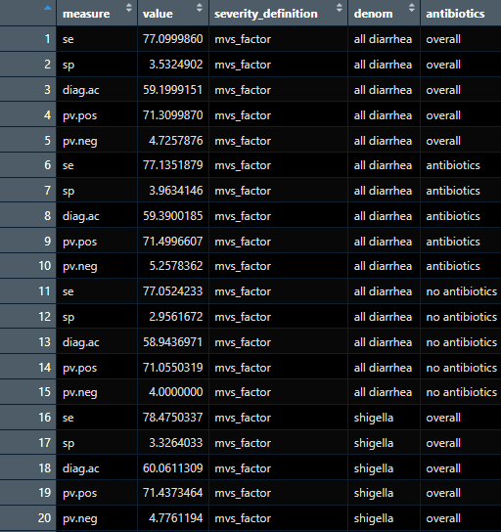
Example 2: running a function through nested for-loops
Notes:
this is what the output looks like!

Slide 54
Example 3: nested functions
names(shigella_results)
> [1] “pid” “enroll_site” “fac_id” “a_factor_weight” “age_group” “serogroup” “hospitalization”
Notes:
Ok, now let’s look at an example with data & a function from EFGH. This dataframe, shigella_results, contains counts of individuals within various subgroups and counts of individuals within those subgroups who were positive for shigella. We are interested in calculating the incidence of shigella within two pairs of groups: first, at the facility vs site level (there are 7 countries or sites, and each has 1 or more recruitment facilities), and second among different subgroups (such as different age groups, serogroups of shigella, and among kids who were hospitalized vs. not).

Slide 55
Example 3: nested functions
INNER FUNCTIONS
facility_fun = function(a) {
shigella_results %>%
filter(!is.na(UQ(sym(a)))) %>%
select(pid, eval(substitute(a)), enroll_site, fac_id, a_factor_weight) %>%
group_by(.data[[a]], enroll_site, fac_id) %>%
summarize(shigella_pos=n(),
shigella_weight=sum(a_factor_weight)))
}
site_fun = function(a) {
shigella_results %>%
filter(!is.na(UQ(sym(a)))) %>%
select(pid, eval(substitute(a)), enroll_site, a_factor_weight) %>%
group_by(enroll_site, .data[[a]]) %>%
summarize(shigella_pos=n(),
shigella_weight=sum(a_factor_weight)))
}
Notes:
Ok, lots going on here.

Slide 56
Example 3: nested functions
INNER FUNCTIONS
facility_fun = function(a) {
shigella_results %>%
filter(!is.na(UQ(sym(a)))) %>%
select(pid, eval(substitute(a)), enroll_site, fac_id, a_factor_weight) %>%
group_by(. data[[a]], enroll_site, fac_id) %>%
summarize(shigella_pos=n(),
shigella_weight=sum(a_factor_weight)))
}
“age_group” “serogroup” “hospitalization”
site_fun = function(a) {
shigella_results %>%
filter(!is.na(UQ(sym(a)))) %>%
select(pid, eval(substitute(a)), enroll_site, a_factor_weight) %>%
group_by(enroll_site, .data[[a]]) %>%
summarize(shigella_pos=n(),
shigella_weight=sum(a_factor_weight)))
}
Input “a”
Notes:
First let’s look at our input “a”. Remember, we are trying to group on both the facility or site level, and then also group on subgroups of interest. These other subgroups of interest, such as age group, serogroup, and hospitalization status, are our input a.

Slide 57
Example 3: nested functions
INNER FUNCTIONS
facility_fun = function(a) {
shigella_results %>%
filter(!is.na(UQ(sym(a)))) %>%
select(pid, eval(substitute(a)), enroll_site, fac_id, a_factor_weight) %>%
group_by(.data[[a]], enroll_site, fac_id) %>%
summarize(shigella_pos=n(),
shigella_weight=sum(a_factor_weight)))
}
Data manipulation “verbs”
site_fun = function(a) {
shigella_results %>%
filter(!is.na(UQ(sym(a)))) %>%
select(pid, eval(substitute(a)), enroll_site, a_factor_weight) %>%
group_by(enroll_site, .data[[a]]) %>%
summarize(shigella_pos=n(),
shigella_weight=sum(a_factor_weight)))
}
Notes:
inside each of these functions we are grouping shigella cases by several variables to obtain 2 new columns: number of shigella positives per group and the weight of each group that will be used to calculate incidence

Slide 58
Example 3: nested functions
INNER FUNCTIONS
facility_fun = function(a) {
shigella_results %>%
filter(!is.na(UQ(sym(a)))) %>%
select(pid, eval(substitute(a)), enroll_site, fac_id, a_factor_weight) %>%
group_by(.data[[a]], enroll_site, fac_id) %>%
summarize(shigella_pos=n(),
shigella_weight=sum(a_factor_weight)))
}
New variables
site_fun = function(a) {
shigella_results %>%
filter(!is.na(UQ(sym(a)))) %>%
select(pid, eval(substitute(a)), enroll_site, a_factor_weight) %>%
group_by(enroll_site, .data[[a]]) %>%
summarize(shigella_pos=n(),
shigella_weight=sum(a_factor_weight)))
}
Notes:
inside each of these functions we are grouping shigella cases by several variables to obtain 2 new columns: number of shigella positives per group and the weight of each group that will be used to calculate incidence

Slide 59
Example 3: nested functions
INNER FUNCTIONS
facility_fun = function(a) {
shigella_results %>%
filter(!is.na(UQ(sym(a)))) %>%
select(pid, eval(substitute(a)), enroll_site, fac_id, a_factor_weight) %>%
group_by(.data[[a]], enroll_site, fac_id) %>%
summarize(shigella_pos=n(),
shigella_weight=sum(a_factor_weight)))
}
Difference between functions
site_fun = function(a) {
shigella_results %>%
filter(!is.na(UQ(sym(a)))) %>%
select(pid, eval(substitute(a)), enroll_site, a_factor_weight) %>%
group_by(enroll_site, .data[[a]]) %>%
summarize(shigella_pos=n(),
shigella_weight=sum(a_factor_weight)))
}
Notes:
The difference between the two functions is that in the first function, we group on both the enrollment site and the facility ID, while in the second function we only group based on the enrollment site

Slide 60
Example 3: nested functions
INNER FUNCTIONS
facility_fun = function(a) {
shigella_results %>%
filter(!is.na(UQ(sym(a)))) %>%
select(pid, eval(substitute(a)), enroll_site, fac_id, a_factor_weight) %>%
group_by(.data[[a]], enroll_site, fac_id) %>%
summarize(shigella_pos=n(),
shigella_weight=sum(a_factor_weight)))
}
Recognizing input “a”
site_fun = function(a) {
shigella_results %>%
filter(!is.na(UQ(sym(a)))) %>%
select(pid, eval(substitute(a)), enroll_site, a_factor_weight) %>%
group_by(enroll_site, .data[[a]]) %>%
summarize(shigella_pos=n(),
shigella_weight=sum(a_factor_weight)))
}
Notes:
Sometimes within functions we need to use special syntax for R to recognize the input as a variable name (it may not be enough to simply put the character a in place of the variable name). There are a few different ways to do this; you may need to research which method works in the context you’re trying to use it.

Slide 61
Example 3: nested functions
INNER FUNCTIONS
facility_fun = function(a) {
shigella_results %>%
filter(!is.na(UQ(sym(a)))) %>%
select(pid, eval(substitute(a)), enroll_site, fac_id, a_factor_weight) %>%
group_by(.data[[a]], enroll_site, fac_id) %>%
summarize(shigella_pos=n(),
shigella_weight=sum(a_factor_weight)))
}
Other tricks for calling variables passed along as function arguments:
Tidyverse glue syntax
{a}
{{a}}
“{a}”
Depracated but sometimes work
!!sym(a)
UQ(sym(a))
eval(substitute(a))
.data[[a]]
Use the walrus operator (:=) instead of the equals sign (=) within dyplr verbs such as mutate
site_fun = function(a) {
shigella_results %>%
filter(!is.na(UQ(sym(a)))) %>%
select(pid, eval(substitute(a)), enroll_site, a_factor_weight) %>%
group_by(enroll_site, .data[[a]]) %>%
summarize(shigella_pos=n(),
shigella_weight=sum(a_factor_weight)))
}
Notes:
Sometimes within functions we need to use special syntax for R to recognize the input as a variable name (it may not be enough to simply put the character a in place of the variable name). There are a few different ways to do this; you may need to research which method works in the context you’re trying to use it.

Slide 62
Example 3: nested functions
INNER FUNCTIONS
facility_fun = function(a) {
shigella_results %>%
filter(!is.na(UQ(sym(a)))) %>%
select(pid, eval(substitute(a)), enroll_site, fac_id, a_factor_weight) %>%
group_by(.data[[a]], enroll_site, fac_id) %>%
summarize(shigella_pos=n(),
shigella_weight=sum(a_factor_weight)))
}
fac_age_results <- facility_fun(“age_group”)
names(fac_age_results)
> [1] “enroll_site” “fac_id” “age_group” “shigella_pos” “shigella_weight”

Slide 63
Example 3: nested functions
INNER FUNCTIONS
site_age_results <- site_fun(“age_group”)
names(site_age_results)
> [1] “enroll_site” “age_group” “shigella_pos” “shigella_weight”
site_fun = function(a) {
shigella_results %>%
filter(!is.na(UQ(sym(a)))) %>%
select(pid, eval(substitute(a)), enroll_site, a_factor_weight) %>%
group_by(enroll_site, .data[[a]]) %>%
summarize(shigella_pos=n(),
shigella_weight=sum(a_factor_weight)))
}

Slide 64
Example 3: nested functions
OUTER FUNCTION
subgroups_fun = function(a, b) {
if(b==“facility”) {
facility_fun(a)
} else if(b==“site”) {
site_fun(a)
} else {print(“Incorrect level selected”)
}
}
Notes:
OUTER FUNCTION, 2-3 SLIDES

Slide 65
Example 3: nested functions
OUTER FUNCTION
subgroups_fun = function(a, b) {
if(b==“facility”) {
facility_fun(a)
} else if(b==“site”) {
site_fun(a)
} else {print(“Incorrect level selected”)
}
}
fac_serogroup_results <- subgroups_fun(“serogroup”)
> “Incorrect level selected”
Notes:
Forgot to specify the second argument

Slide 66
Example 3: nested functions
OUTER FUNCTION
subgroups_fun = function(a, b) {
if(b==“facility”) {
facility_fun(a)
} else if(b==“site”) {
site_fun(a)
} else {print(“Incorrect level selected”)
}
}
fac_serogroup_results <- subgroups_fun(“serogroup”, “facility”)
names(fac_serogroup_results)
> [1] “enroll_site” “fac_id” “serogroup” “shigella_pos” “shigella_weight”
Notes:
Can use this outer function to run through pairs of arguments, coallate results into one dataframe

Slide 67

map

Slide 68
structure
map(.x, .f)
map_df(.x, .f)
map_dbl(.x, .f)
map_chr(.x, .f)
map_lgl(.x, .f)
2 inputs: data (.x) and function (.f)
Because data is the first argument of all map functions, works well with piping syntax
Above functions return different types of objects, in order: list, dataframe, double (numeric) vector, character vector, logical vector

Slide 69
map with vectors
map_chr(c(“Red”, “Green”, “Yellow”), ~ paste0(.x, “ apple”)
[1] “Red apple” “Green apple” “Yellow apple”
map_chr(c(“Dogs are excellent”, “Cats are excellent”), \(value) str_replace(value, “excellent”, “great”)
[1] “Dogs are great” “Cats are great”
c(4, 19, 8) |> map_dbl(~ . + 5)
[1] 9 24 13

Slide 70
map with vectors
map_chr(c(“Red”, “Green”, “Yellow”), ~ paste0(.x, “ apple”)
[1] “Red apple” “Green apple” “Yellow apple”
map_chr(c(“Dogs are excellent”, “Cats are excellent”), \(value) str_replace(value, “excellent”, “great”)
[1] “Dogs are great” “Cats are great”
c(4, 19, 8) |> map_dbl(~ . + 5)
[1] 9 24 13
Map function
Notes:
different map functions for character and double (numeric) vectors

Slide 71
map with vectors
map_chr(c(“Red”, “Green”, “Yellow”), ~ paste0(.x, “ apple”)
[1] “Red apple” “Green apple” “Yellow apple”
map_chr(c(“Dogs are excellent”, “Cats are excellent”), \(value) str_replace(value, “excellent”, “great”)
[1] “Dogs are great” “Cats are great”
c(4, 19, 8) |> map_dbl(~ . + 5)
[1] 9 24 13
Input data
Notes:
in the first two examples, the input data is defined within the map function. in the third example, the data is defined previously and the map function is piped in afterwards. notice that the data is not re-specified within the map function; it is understood that the data piped in is the first argument

Slide 72
map with vectors
map_chr(c(“Red”, “Green”, “Yellow”), ~ paste0(.x, “ apple”)
[1] “Red apple” “Green apple” “Yellow apple”
map_chr(c(“Dogs are excellent”, “Cats are excellent”), \(value) str_replace(value, “excellent”, “great”)
[1] “Dogs are great” “Cats are great”
c(4, 19, 8) |> map_dbl(~ . + 5)
[1] 9 24 13
User-specified function
Notes:
note that there are several approaches to defining functions within the map function. here, we are using a technique called “anonymous functions” and the formula symbol

Slide 73
map with vectors
new_function = function(x) {x * 2}
new_function(2)
4
map_chr(c(“Red”, “Green”, “Yellow”), ~ paste0(.x, “ apple”)
[1] “Red apple” “Green apple” “Yellow apple”
map_chr(c(“Dogs are excellent”, “Cats are excellent”), \(value) str_replace(value, “excellent”, “great”)
[1] “Dogs are great” “Cats are great”
c(4, 19, 8) |> map_dbl(~ . + 5)
[1] 9 24 13
User-specified function
Notes:
typical functions in R are named using the syntax function(x) and curly brackets. but this is not concise, and we may not need to give all functions a name (especially those occurring within functions like map where we may just be manipulating data)

Slide 74
map with vectors
map_chr(c(“Red”, “Green”, “Yellow”), ~ paste0(.x, “ apple”)
[1] “Red apple” “Green apple” “Yellow apple”
map_chr(c(“Dogs are excellent”, “Cats are excellent”), \(value) str_replace(value, “excellent”, “great”)
[1] “Dogs are great” “Cats are great”
c(4, 19, 8) |> map_dbl(~ . + 5)
[1] 9 24 13
User-specified function
Notes:
instead, we can use the formula symbol which is a tilde. map will automatically understand .x or . to be the function input; you can use either interchangeably.
another alternative is to use an anonymous function, where instead of writing out function(x) we can use a backwards slash. in the second example, I’ve defined the function input as “value”, but you could use any string here (for example, x, df)

Slide 75
map with dataframes
data.frame(a = c(1, 2, 3), b = c(2, 5, 4), c = c(3, 2, 5)) |> map_df(~ .x + 5)
a b c
[1] 6 7 8
[2] 7 10 7
[3] 8 9 10
Notes:
in this example, the function is applied to the entire dataframe

Slide 76
map with dataframes
data.frame(a = c(1, 99, 3), b = c(2, 5, 4), c = c(99, 2, 5)) |> map_df(~ ifelse(.x==99, NA, .x))
a b c
[1] 6 7 NA
[2] NA 10 7
[3] 8 9 10
Notes:
we can use this for more complex functions – for example, let’s replace all values of 99 in a dataframe with NA

Slide 77
example 1: filter all datasets to the same date range
data_date = as.Date(“2024-01-01”)
included_pids = scrambled_data$pid[scrambled_data$enroll_date<data_date]
Notes:
in this example, we would like to generate a report using data collected through a certain date
this is to avoid reporting on data that hasn't been queried yet
our goal is to reproduce each dataset so that it only contains data from the desired date range
first, we will make a vector of all the pids that were enrolled prior to the date of interest (January 1, 2024)
note that these datasets occur on the same point in time, so when filtering by date we can just specify the date of enrollment. for longitudinal data (i.e., if we had forms taken at follow-up), we may need to create a pid list for each point in time.

Slide 78
example 1: filter all datasets to the same date range
dataframes = list(scrambled_data = scrambled_data,
scrambled_preenrollment = scrambled_preenrollment)
report_date_data = dataframes |>
map(\(df) df |> filter(pid %in% included_pids)
list2env(report_date_data, envir = .GlobalEnv)
List with dataframes
Notes:
next, we will create a list of all the dataframes of interest, where we assign each dataframe in the list the same name of the original dataframe. for now, we will just use the dataframes that have a pid column.

Slide 79
example 1: filter all datasets to the same date range
dataframes = list(scrambled_data = scrambled_data,
scrambled_preenrollment = scrambled_preenrollment)
report_date_data = dataframes |>
map(\(df) df |> filter(pid %in% included_pids)
list2env(report_date_data, envir = .GlobalEnv)
Map function
Notes:
the map function filters out just the observations in the pid list we made earlier for all dataframes in the “dataframes” list

Slide 80
example 1: filter all datasets to the same date range
dataframes = list(scrambled_data = scrambled_data,
scrambled_preenrollment = scrambled_preenrollment)
report_date_data = dataframes |>
map(\(df) df |> filter(pid %in% included_pids)
list2env(report_date_data, envir = .GlobalEnv)
Export dataframes to global environment
Notes:
however, these dataframes are still stored in a list format. to write them back as dataframes that can be manipulated in the global environment, we use the function list2env

Slide 81
example 2: fix inconsistencies across datasets for merging
rbind(scrambled_prescreening, scrambled_screening)
Error in rbind(deparse.level, …) : numbers of columns of arguments do not match
rbind(scrambled_prescreening, scrambled_screening |> select(-scr_diar_when)
serial_id date eligible
<chr> <chr> <chr>
181211173 2022-07-04 12:54 1
520791573 2022-07-05 09:58 1
816673173 2022-07-05 10:22 0
Notes:
in this example, we would like to combine the rows of three datasets (scrambled_prescreening, scrambled_screening, scrambled_preenrollment). we will do this by stacking the dataframes on top of each other using rbind. in order to do so, we need to make sure the corresponding columns in each of the datasets align
when we try to simply use the command rbind, we run into issues – there are a different number of columns. when we fix that by removing the extra column, we still have an issue. the columns are all in character format, when we want serial_id and eligible to be numeric and date to be date.

Slide 82

example 2: fix inconsistencies across datasets for merging
rbind(scrambled_prescreening, scrambled_screening)
Error in rbind(deparse.level, …) : numbers of columns of arguments do not match
rbind(scrambled_prescreening, scrambled_screening |> select(-scr_diar_when)
serial_id date eligible
<chr> <chr> <chr>
181211173 2022-07-04 12:54 1
520791573 2022-07-05 09:58 1
816673173 2022-07-05 10:22 0
Notes:
map can make this process more efficient!

Slide 83
example 2: fix inconsistencies across datasets for merging
screening_list = list(scrambled_prescreening = scrambled_prescreening, scrambled_screening = scrambled_ screening,
scrambled_preenrollment = scrambled_preenrollment)
Notes:
first we’ll make a list containing the dataframes of interest

Slide 84
example 2: fix inconsistencies across datasets for merging
screening_list = list(scrambled_prescreening = scrambled_prescreening, scrambled_screening = scrambled_ screening,
scrambled_preenrollment = scrambled_preenrollment)
combined_screening_forms = screening_list |>
map(\(df) df |> mutate(across(everything(), ~ ifelse(.x=="", NA, .x)))) |>
map(\(df) df |> mutate(across(c(serial_id, eligible), ~ as.numeric(.x)))) |>
map(\(df) df |> mutate(across(c(date), ~ as.Date(.x)))) |>
map(\(df) df |> select(any_of(c("serial_id", "date", "eligible")))) |>
list_rbind(names_to = "form") |>
mutate(form = str_replace(form, "scrambled_", ""))
Using map to harmonize data
Notes:
next, we will use a series of map functions to clean the data within all dataframes before combining it together

Slide 85
example 2: fix inconsistencies across datasets for merging
screening_list = list(scrambled_prescreening = scrambled_prescreening, scrambled_screening = scrambled_ screening,
scrambled_preenrollment = scrambled_preenrollment)
combined_screening_forms = screening_list |>
map(\(df) df |> mutate(across(everything(), ~ ifelse(.x=="", NA, .x)))) |>
map(\(df) df |> mutate(across(c(serial_id, eligible), ~ as.numeric(.x)))) |>
map(\(df) df |> mutate(across(c(date), ~ as.Date(.x)))) |>
map(\(df) df |> select(any_of(c("serial_id", "date", "eligible")))) |>
list_rbind(names_to = "form") |>
mutate(form = str_replace(form, "scrambled_", ""))
Notes:
the first row replaces blank cells with NA values, which are easier to manipulate in R. the across(everything()) function ensures this is applied to all columns in all dataframes

Slide 86
example 2: fix inconsistencies across datasets for merging
screening_list = list(scrambled_prescreening = scrambled_prescreening, scrambled_screening = scrambled_ screening,
scrambled_preenrollment = scrambled_preenrollment)
combined_screening_forms = screening_list |>
map(\(df) df |> mutate(across(everything(), ~ ifelse(.x=="", NA, .x)))) |>
map(\(df) df |> mutate(across(c(serial_id, eligible), ~ as.numeric(.x)))) |>
map(\(df) df |> mutate(across(c(date), ~ as.Date(.x)))) |>
map(\(df) df |> select(any_of(c("serial_id", "date", "eligible")))) |>
list_rbind(names_to = "form") |>
mutate(form = str_replace(form, "scrambled_", ""))
Notes:
the second and third row specify that serial_id and eligible should be transformed to numeric columns and date should be a date column

Slide 87
example 2: fix inconsistencies across datasets for merging
screening_list = list(scrambled_prescreening = scrambled_prescreening, scrambled_screening = scrambled_ screening,
scrambled_preenrollment = scrambled_preenrollment)
combined_screening_forms = screening_list |>
map(\(df) df |> mutate(across(everything(), ~ ifelse(.x=="", NA, .x)))) |>
map(\(df) df |> mutate(across(c(serial_id, eligible), ~ as.numeric(.x)))) |>
map(\(df) df |> mutate(across(c(date), ~ as.Date(.x)))) |>
map(\(df) df |> select(any_of(c("serial_id", "date", "eligible")))) |>
list_rbind(names_to = "form") |>
mutate(form = str_replace(form, "scrambled_", ""))
Notes:
the fourth row selects only the three columns that will be merged from each dataset

Slide 88
example 2: fix inconsistencies across datasets for merging
screening_list = list(scrambled_prescreening = scrambled_prescreening, scrambled_screening = scrambled_ screening,
scrambled_preenrollment = scrambled_preenrollment)
combined_screening_forms = screening_list |>
map(\(df) df |> mutate(across(everything(), ~ ifelse(.x=="", NA, .x)))) |>
map(\(df) df |> mutate(across(c(serial_id, eligible), ~ as.numeric(.x)))) |>
map(\(df) df |> mutate(across(c(date), ~ as.Date(.x)))) |>
map(\(df) df |> select(any_of(c("serial_id", "date", "eligible")))) |>
list_rbind(names_to = "form") |>
mutate(form = str_replace(form, "scrambled_", ""))
Combine dataframes
Notes:
finally, we feed this list to the list_rbind() function which combines all the dataframes in the list into a single dataframe

Slide 89

apply family

Slide 90
why a “family”?
There are many functions in the apply “family”
Most commonly used: apply, lapply, sapply, mapply
Which one you use depends on your input and output data structure
apply: input matrix/array; output matrix/array
lapply: input vector, dataframe or list; output list
sapply: input vector, dataframe or list; output vector, dataframe, or list
mapply: input multiple vectors, dataframes, or lists; output vector, dataframe, or list

Slide 91
structure
apply(X, MARGIN, FUN, …)
At least 3 inputs
X: input data (vector, dataframe, matrix, list, …)
MARGIN: defines how function is applied
MARGIN=1 -> function applied over rows
MARGIN=2 -> function applied over columns
FUN: function to be applied over data

Slide 92
Applying functions over rows and columns
Sum rows of a dataframe
rowsum <- apply(scrambled_data[c(“water_drink_level”, “sanitation_level”)], 1, sum)
rowsum
> [1] 2 2 2 2 2 2 2 2 2 2 2 2 2 2 2 2 2 5 2 2 2 2 3 3 2 2 2 2
Column means in a dataframe
colmean <- apply(scrambled_data[c(5, 7)], 2, mean)
colmean
> enroll_cg_age enr_age_months
26.7 15.7
Notes:
let’s walk through two basic examples of using apply functions. in the first, we would like to take the sum across rows in our dataset. in the second, we would like to take the mean of columns in our dataset

Slide 93
Applying functions over rows and columns
Sum rows of a dataframe
rowsum <- apply(scrambled_data[c(“water_drink_level”, “sanitation_level”)], 1, sum)
rowsum
> [1] 2 2 2 2 2 2 2 2 2 2 2 2 2 2 2 2 2 5 2 2 2 2 3 3 2 2 2 2
Data
Column means in a dataframe
colmean <- apply(scrambled_data[c(5, 7)], 2, mean)
colmean
> enroll_cg_age enr_age_months
26.7 15.7
Notes:
the first argument specifies the data to be used. note that in each of these examples, we specify a subset of columns. this is because not all columns in our dataset are numeric, so we would not be able to sum or average all of them. for the first example, we are adding the scores for household water drinking and sanitation, where higher scores indicate lower level of water or sanitation service. in the second example, we are taking the average age of all caregivers and enrolled children in the study (in years and months, respectively)

Slide 94
Applying functions over rows and columns
Sum rows of a dataframe
rowsum <- apply(scrambled_data[c(“water_drink_level”, “sanitation_level”)], 1, sum)
rowsum
> [1] 2 2 2 2 2 2 2 2 2 2 2 2 2 2 2 2 2 5 2 2 2 2 3 3 2 2 2 2
Margin
(rows vs. columns)
Column means in a dataframe
colmean <- apply(scrambled_data[c(5, 7)], 2, mean)
colmean
> enroll_cg_age enr_age_months
26.7 15.7
Notes:
this second argument, the “margin”, specifies whether we are working across rows (1) or columns (2)

Slide 95
Applying functions over rows and columns
Sum rows of a dataframe
rowsum <- apply(scrambled_data[c(“water_drink_level”, “sanitation_level”)], 1, sum)
rowsum
> [1] 2 2 2 2 2 2 2 2 2 2 2 2 2 2 2 2 2 5 2 2 2 2 3 3 2 2 2 2
Function
Column means in a dataframe
colmean <- apply(scrambled_data[c(5, 7)], 2, mean)
colmean
> enroll_cg_age enr_age_months
26.7 15.7
Notes:
the third argument specifies the function we are applying to the dataframe. it is important to remember that the resulting object will be returned in the relevant dimension (i.e., number of rows for left example and number of columns for right example)

Slide 96
Example 1: matching values by row across subset of columns
scrambled_repeat_sex$sex_match <- ifelse(apply(df[c(2:5)],
1,
function(x) length(unique(na.omit(x)))) == 1, 1, 0)
scrambled_repeat_sex$sex_match
> [1] 1 1 1
Notes:
In the first example, we are looking at children who were enrolled multiple times in EFGH. as a data cleaning process, we looked at these children to see if the sex matched up across all enrollments

Slide 97
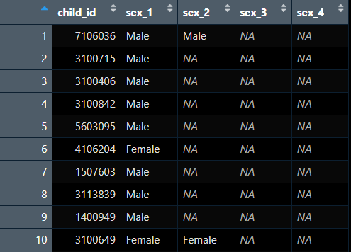
Example 1: matching values by row across subset of columns
scrambled_repeat_sex$sex_match <- ifelse(apply(df[c(2:5)],
1,
function(x) length(unique(na.omit(x)))) == 1, 1, 0)
scrambled_repeat_sex$sex_match
> [1] 1 1 1
Notes:
to do this, we created a new variable “sex_match” using ifelse() and apply(). The apply helped us examine whether all existing sex designations across several columns matched each other

Slide 98
Example 1: matching values by row across subset of columns
scrambled_repeat_sex$sex_match <- ifelse(apply(df[c(2:5)],
1,
function(x) length(unique(na.omit(x)))) == 1, 1, 0)
scrambled_repeat_sex$sex_match
> [1] 1 1 1
Can specify which columns function should be applied to

Slide 99
Example 1: matching values by row across subset of columns
scrambled_repeat_sex$sex_match <- ifelse(apply(df[c(2:5)],
1,
function(x) length(unique(na.omit(x)))) == 1, 1, 0)
scrambled_repeat_sex$sex_match
> [1] 1 1 1
Applied along rows

Slide 100
Example 1: matching values by row across subset of columns
scrambled_repeat_sex$sex_match <- ifelse(apply(df[c(2:5)],
1,
function(x) length(unique(na.omit(x)))) == 1, 1, 0)
scrambled_repeat_sex$sex_match
> [1] 1 1 1
User-specified function

Slide 101
Example 2: univariate regression
out_mort <- sapply(pred, function(x) {
form <- as.formula(paste0("infant_death~", x))
model <- glm(form, data = data, family = "binomial", na.action = na.omit)
mort_out = data.frame(matrix(vector(), 6, 20, dimnames = list(param_est, pred)))
mort_out[,x] <- c(summary(model)$coefficients[1,], exp(confint(model))[2,])
})
pred = c("age", "education", "marital“)
param_est = c("coef", "se(coef)", "z", "p", "cilow", "cihigh")
head(data)
> Study.ID infant_death age education marital
1 10000 0 34 1 1
2 10001 0 19 1 0
3 10002 1 23 1 0
4 10003 0 20 0 1

Slide 102
Example 2: univariate regression
out_mort <- sapply(pred, function(x) {
form <- as.formula(paste0("infant_death~", x))
model <- glm(form, data = data, family = "binomial", na.action = na.omit)
mort_out = data.frame(matrix(vector(), 6, 20, dimnames = list(param_est, pred)))
mort_out[,x] <- c(summary(model)$coefficients[1,], exp(confint(model))[2,])
})
pred = c("age", "education", "marital“)
param_est = c("coef", "se(coef)", "z", "p", "cilow", "cihigh")
head(data)
> Study.ID infant_death age education marital
1 10000 0 34 1 1
2 10001 0 19 1 0
3 10002 1 23 1 0
4 10003 0 20 0 1
Existing objects…

Slide 103
Example 2: univariate regression
out_mort <- sapply(pred, function(x) {
form <- as.formula(paste0("infant_death~", x))
model <- glm(form, data = data, family = "binomial", na.action = na.omit)
mort_out = data.frame(matrix(vector(), 6, 20, dimnames = list(param_est, pred)))
mort_out[,x] <- c(summary(model)$coefficients[1,], exp(confint(model))[2,])
})
pred = c("age", "education", "marital“)
param_est = c("coef", "se(coef)", "z", "p", "cilow", "cihigh")
head(data)
> Study.ID infant_death age education marital
1 10000 0 34 1 1
2 10001 0 19 1 0
3 10002 1 23 1 0
4 10003 0 20 0 1
…used here

Slide 104
Example 2: univariate regression
out_mort <- sapply(pred, function(x) {
form <- as.formula(paste0("infant_death~", x))
model <- glm(form, data = data, family = "binomial", na.action = na.omit)
mort_out = data.frame(matrix(vector(), 6, 20, dimnames = list(param_est, pred)))
mort_out[,x] <- c(summary(model)$coefficients[1,], exp(confint(model))[2,])
})
pred = c("age", "education", "marital“)
param_est = c("coef", "se(coef)", "z", "p", "cilow", "cihigh")
head(data)
> Study.ID infant_death age education marital
1 10000 0 34 1 1
2 10001 0 19 1 0
3 10002 1 23 1 0
4 10003 0 20 0 1
Objects we create
Notes:
Question for group: where are the first three objects created (global environment) and where are the second set of three objects created (local environment)?
Explain that although local environments are not created within apply functions, they are created within the function within apply
What does this mean about how the second three objects will change as sapply runs through the three values of “pred”?
- form will change with each new iteration as “x” is replaced with the predictor variable
- model will also change with each new iteration
- mort_out will be created by the first line on the first iteration; however, because the first line regarding mort_out does not contain any values, only dimensions, the data will not be rewritten on each iteration. Thus, with each iteration, a new column of the data will be filled in

Slide 105
Example 2: univariate regression
out_mort <- sapply(pred, function(x) {
form <- as.formula(paste0("infant_death~", x))
model <- glm(form, data = data, family = "binomial", na.action = na.omit)
mort_out = data.frame(matrix(vector(), 6, 20, dimnames = list(param_est, pred)))
mort_out[,x] <- c(summary(model)$coefficients[1,], exp(confint(model))[2,])
})
pred = c("age", "education", "marital“)
param_est = c("coef", "se(coef)", "z", "p", "cilow", "cihigh")
head(data)
> Study.ID infant_death age education marital
1 10000 0 34 1 1
2 10001 0 19 1 0
3 10002 1 23 1 0
4 10003 0 20 0 1
Objects we create
Notes:
What does this mean about how the second three objects will change as sapply runs through the three values of “pred”?
- form will change with each new iteration as “x” is replaced with the predictor variable
- model will also change with each new iteration
- mort_out will be created by the first line on the first iteration; however, because the first line regarding mort_out does not contain any values, only dimensions & dimnames, the data will not be rewritten on each iteration. Thus, with each iteration, a new column of the data will .be filled in

Slide 106
Example 2: univariate regression
out_mort
> age education marital
[1, ] -0.01 -0.07 -0.16
[2, ] 0.02 0.21 0.26
[3, ] -0.36 -0.36 -0.64
[4, ] 0.72 0.73 0.52
[5, ] 0.95 0.61 0.52
[6, ] 1.03 1.42 1.44

Slide 107
Example 2: univariate regression
out_mort
> age education marital
[1, ] -0.01 -0.07 -0.16
[2, ] 0.02 0.21 0.26
[3, ] -0.36 -0.36 -0.64
[4, ] 0.72 0.73 0.52
[5, ] 0.95 0.61 0.52
[6, ] 1.03 1.42 1.44
Row names didn’t come out ☹
Intended:
coef
se(coef)
z
p
cilow
cihigh

Slide 108

Do I even need a loop or function?

Slide 109
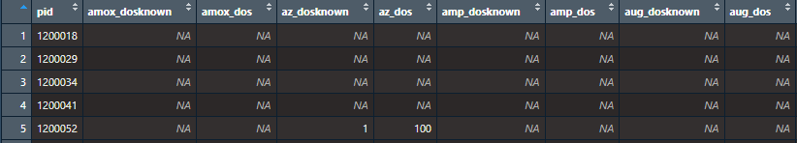
Sometimes…no
Example problem
Compare values from 2 columns by variable name
Iterating through 20+ pairs of columns
Notes:
Impossible combination: if the dose for a medication is known (_dosknown), we shouldn’t see values of 99 (“don’t know”) in the second question (_dos)
This would be a lot of column pairs to check manually!

Slide 110
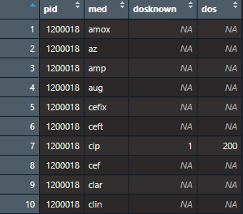
Alternative: Pivoting
long_medication <- scrambled_medication %>%
pivot_longer(!pid, names_to = c(“med”, “.value”), names_sep = “_”)
Notes:
We can pivot the dataframe into a long orientation so that the values from the two questions are on a separate line for each medication

Slide 111
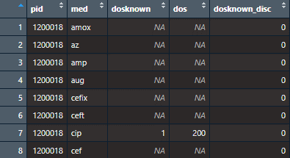
Alternative: Pivoting
long_medication <- scrambled_medication %>%
pivot_longer(!pid, names_to = c(“med”, “.value”), names_sep = “_”) %>%
mutate(dosknown_disc = ifelse(dosknown==1 & !is.na(dosknown) & is.na(dos), 1,
ifelse(dosknown==1 & !is.na(dosknown) & dos==99 & !is.na(dos), 1, 0)))
Notes:
Then we can compare the values directly with each pair on a separate row

Slide 112
comparison
Type | Characteristics
For-loops | Somewhat more intuitive syntax Requires understanding local vs. global environments
Functions | Necessary to understand to use other forms of iteration Requires understanding local vs. global environments
Map family | Updated version of apply family Compatible with tidyverse syntax, verbs, and piping
Apply family | Can succinctly loop over cols/rows in dataframes Difficult syntax; steep learning curve

Slide 113

Summary & considerations
Multiple ways to approach any given problem
Global environment vs. environment within loop/function
Calling variable names within function & for loops may require specialized characters
Lists are your friend

Slide 114
references & resources
Map functions: https://rebeccabarter.com/blog/2019-08-19_purrr

Slide 115
Thank you!!

